Slide 1
Process Mapping

Slide 2

Other Modules In This Series:
5S
Standard Work
Total Productive Maintenance (TPM)
Administrative Lean
Cell Design/ Production Preparation Process (3P)
Kaizen
Kanban
Problem Solving
Poka Yoke Quality Systems
Transaction Process Improvement (TPI)
Cause & Effect Diagram with the Additions of Cards (CEDAC)
Single Minute Exchange of Dies (SMED)
Value Stream Mapping (VSMi®)
Visual Management
Managing Daily Process Excellence
For More Information Please Contact:
Mark DeLuzio, President and CEO
+1.860.234.0915
mark.deluzio@leanhorizons.com
Strategically Creating Value Through the Elimination of Waste

Slide 3
This document contains confidential
and proprietary information owned
by Lean Horizons Consulting, LLC.
Any disclosure, use, copying or
distribution of this information without the express written consent of Lean Horizons Consulting is strictly prohibited.

Slide 4
Ground Rules for Event
Safety first (use personal protective equipment)
Active participation by all
Start and end on time
All electronic gadgets (phones, pagers, etc) turned to “off” or “silent”
Computers to be used only when instructed
Keep an open mind to change
Don’t let “perfect” get in the way of “better”
Notes:
DO: Perform Group Introductions. Pick an ice-breaker or exercise to warm the team up to the event. (Icebreaker Example: Everyone uses their name tent and writes a “Personal License Plate” in which they have 2 minutes to creatively use a total of 7 letters or numbers to tell us something about themselves. Examples “LV2SAIL” OR “DADOV5”
DO: Review Event Ground Rules.
ASK: “Does anyone have any rules they would like to see added?”
ASK: “Does everyone agree to these?”

Slide 5
Goal of Process Mapping Module
To apply Process Mapping to achieve a target goal for your business.
Process
Mapping
Definition
Steps to
Process
Mapping
Process
Mapping
Review
Notes:
DO: Introduce the notion of Process Mapping and the goal of this event.
At this time it is appropriate for the Process Owner or the Kaizen Team Leader to review the kaizen charter and objectives of the event.

Slide 6
Process Mapping
Process Mapping
Definition
Steps to
Process
Mapping
Process
Mapping
Review
Objectives:
Define Process Mapping
Identify purpose and benefits of Process Mapping
Identify components of a process
Define levels of process mapping
Discuss team requirements
Notes:
DO: Review chapter objectives.

Slide 7


Introduction to Process Mapping
Process Mapping Definition
What is wrong with this picture?
A picture is worth a thousand words

Slide 8

Process Mapping
Process Mapping Definition
Graphic display of steps, events and operations that constitute a process
A picture or diagram of what is actually happening
A foundation for continuous improvement
A real-time planning and implementation tool

Slide 9
Benefits of Process Mapping
Process Mapping Definition
Provides excellent reference point for continuous improvement
  Facilitates reduced cycle time and improved output
Reduces ambiguous, complex processes to finite tasks
  Helps learn focus on facts not opinions
Highlights functional interdependencies
Notes:
SAY: “It is important to understand that mapping is only a tool. It is one element in successful process improvement.”

Slide 10
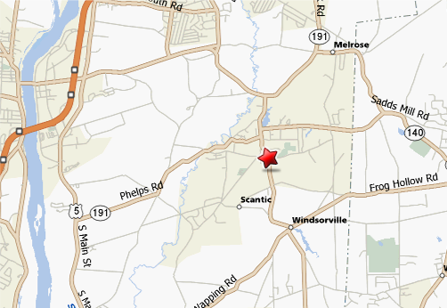
Process Mapping
Process Mapping Definition
Using the Process Map
Process Mapping is a tool used for continuous improvement
Similar in concept to a roadmap:
  Here is where we agree we are now (present situation)
  Here is where we want to be (goal destination or ideal situation)
  Here are our options to get there
Notes:
SAY: “In representing accurately what a process is, the process map uncovers opportunities for improvement, and this is how it fits into the concept of continuous process improvement. Your team should understand what a process map is by considering the metaphor of the road map.”

Slide 11
Any Process has at least three versions
Process Mapping Definition
What you THINK it is:
What it ACTUALLY is:
What it SHOULD be:

Slide 12
What makes up a process?
Process Mapping Definition
Control
Process
Input
Output
Mechanism

Slide 13
Levels of Process Mapping
Process Mapping Definition
Macro or Organizational Level Process
Unbundling Process
Nested Process Level
To effectively break processes down to components, drawing on the knowledge of process experts is the “best practice”
Sub Process or
Job Level

Slide 14
Establish teams to address key business issues
Process Mapping Definition
Get the right mix of players
  Natural interest and focus
  Understand the process
  Closest to the process
Understand needs and expectations

Slide 15
Exercise: Process Mapping Charter Review
Process Mapping Definition
Objective
Review the Process Mapping Charter for the event against charter criteria
Instructions
Time to Complete
As a team review the event charter and answer the following questions:
What is the business need for this event?
What are the clear geographic boundaries?
Who is the owner?
What are the goals for this event?
30 minutes
Deliverable
Make any modifications
to charter as necessary.
Notes:
DO: Review the charter for this event.

Slide 16
Steps to Process Mapping
Process Mapping
Definition
Steps to
Process
Mapping
Process
Mapping
Review
Objectives:
Identify each of the basic steps to Process Mapping
Define each step in detail
Notes:
DO: Review chapter objectives.

Slide 17
Basic steps to Process Mapping
Steps to Process Mapping
    1. Define the boundaries of the process
2. Brainstorm and storyboard
3. Document the current process
4. Walk the process
5. Change the map
6. Identify improvements
7. Create new process map
8. Validate the new process
9. Standardize the new process

Slide 18
Basic steps to Process Mapping
Steps to Process Mapping
    1. Define the boundaries of the process
2. Brainstorm and storyboard
3. Document the current process
4. Walk the process
5. Change the map
6. Identify improvements
7. Create new process map
8. Validate the new process
9. Standardize the new process

Slide 19
Define the boundaries of the process
Steps to Process Mapping
INPUT
OUTPUT
START BOUNDARY
What must my suppliers provide my process to
meet my needs?
PROCESS
Agree on the
beginning
and end of
the process
to be
analyzed
STOP BOUNDARY
How can I assure that
my process output meets
the needs of my customer?

Slide 20
Basic steps to Process Mapping
Steps to Process Mapping
    1. Define the boundaries of the process
2. Brainstorm and storyboard
3. Document the current process
4. Walk the process
5. Change the map
6. Identify improvements
7. Create new process map
8. Validate the new process
9. Standardize the new process

Slide 21

Brainstorming and Storyboarding
Steps to Process Mapping
Identify the process using brainstorming and storyboarding techniques
Start rapidly writing process steps on cards and placing them on the wall
  Don’t try to establish order
  Don’t use different colored cards or symbols
  Don’t discuss process steps in detail

Slide 22
Ground Rules and Guidelines
Process Mapping Definition
Be open ….. generate ideas freely and rapidly
Be positive, supportive, non-critical…..do not ‘criticize’
Be willing to share your thoughts and feelings
Keep it simple
Team-play only
Build on the ideas of others
Try different and ‘wild’ directions
Avoid long discussions on any one idea

Slide 23
Basic steps to Process Mapping
Steps to Process Mapping
    1. Define the boundaries of the process
2. Brainstorm and storyboard
3. Document the current process
4. Walk the process
5. Change the map
6. Identify improvements
7. Create new process map
8. Validate the new process
9. Standardize the new process

Slide 24
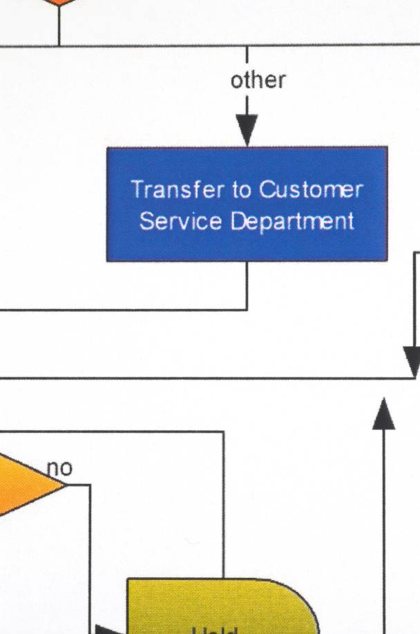
Document Current Process
Steps to Process Mapping
Create a flowchart to arrange the process steps in time sequence
Document current process and identify customer/supplier relationships
Document the current way things are actually done, not the ideal, in order to identify opportunities
Keep a record of problems, ideas or suggestions for change

Slide 25
Flow Charting
Steps to Process Mapping
Start with the input that initiates the process
Ask, “What happens next?”
Record each step in boxes flowing from left to right or top to bottom. Put in arrows to show the flow of the process
When the flow can go in two directions, draw a diamond around a yes/no question and put in two arrows to show the two directions
Make sure each branch of the flow chart is complete
Always sign and date the flow chart for future reference

Slide 26
Process Flow Diagramming Symbols
Steps to Process Mapping
Operation
A Step in the process
that adds value.
Transportation
To move from one place to
another. (Not part of an
operation or inspection.
Measurement
To inspect, verify, count,
examine, gage for quality
or quantity.
Transmission
To send information by
electronic means.
Storage
To hold for later use.
(I.e., in a queue).
Decision
A step in the process where
a change in the flow may
occur.
Delay
To wait for the next operation.
(I.e., in a queue).
No value added.

Slide 27
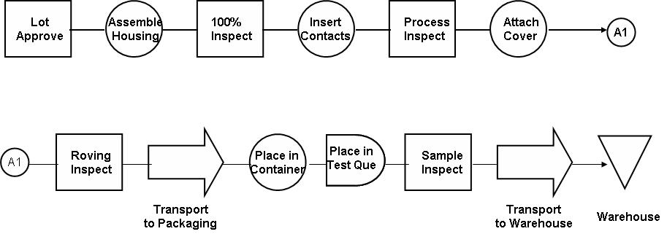
Tasks Performed in Series
Steps to Process Mapping

Slide 28
Tasks Performed in Parallel
Steps to Process Mapping
Submit
for
Approval
Insert
report In
Envelopes
Type
Report
Proof
Read
A
Mail Reports
Deliver to
Clerk
Type
Addresses
on
Envelopes
Obtain
Distribution
list
Check for
Errors

Slide 29
Tasks Performed Simultaneously
Steps to Process Mapping
Grind
and
Inspect
Drill
Center
Hole
Check for
Burrs While
Packaging
Transport
to next
Operation

Slide 30
Helpful Hint
Steps to Process Mapping
Segregate process steps by department or function
Accounts Payable
MIS
Controller
Inspect
Invoice
Enter into
System
Inspect
Input
Report
Generate
Checks
Review
Budget
Approve

Slide 31
Basic steps to Process Mapping
Steps to Process Mapping
    1. Define the boundaries of the process
2. Brainstorm and storyboard
3. Document the current process
4. Walk the process
5. Change the map
6. Identify improvements
7. Create new process map
8. Validate the new process
9. Standardize the new process

Slide 32

Walk the Process
Steps to Process Mapping
Use this step to validate your flowchart
Note changes to your documented flow
© Reprinted with permission from BigStockPhoto.com

Slide 33
Basic steps to Process Mapping
Steps to Process Mapping
    1. Define the boundaries of the process
2. Brainstorm and storyboard
3. Document the current process
4. Walk the process
5. Change the map
6. Identify improvements
7. Create new process map
8. Validate the new process
9. Standardize the new process

Slide 34

Change the Map
Steps to Process Mapping
Change the map to match the physical flow
Concentrate on how the process exists at this point
© Reprinted with permission from BigStockPhoto.com

Slide 35
Basic steps to Process Mapping
Steps to Process Mapping
    1. Define the boundaries of the process
2. Brainstorm and storyboard
3. Document the current process
4. Walk the process
5. Change the map
6. Identify improvements
7. Create new process map
8. Validate the new process
9. Standardize the new process

Slide 36
Identify Improvements
Steps to Process Mapping
Now that the maps are developed, ask the following questions
Based on your problem/opportunity statement:
  Waste?
  Delays?
  Bad product?
  Bad service?
  Inventory queues?
  Is it critical?
  Is it controlled? How?
  Does it add value? To which customer is it related?

Slide 37
Re’s: Anything in your process done again
Steps to Process Mapping
Action Verbs beginning with the Prefix Re
Rework
Retrain
Remeasure
Remake
Repeat
Retest
Reject
Reissue
Recheck
Return
Rewrite
Retype
Redesign
Reship
Recall
Each “Re” typically causes a backwards loop in the process
Identify from your Process Map where the Re’s are Occurring

Slide 38
Re’s: Anything in your process done again
Steps to Process Mapping
Is there specific places
set aside for these
activities?
Identify your team’s top Re’s:
__________________________
__________________________
__________________________
__________________________
__________________________
__________________________
Is there a budget for any
of these activities?
Is schedule slack allowed
for these activities
Is there buffer stock inventory
set aside to accommodate
these activities
RE’s!

Slide 39
Basic steps to Process Mapping
Steps to Process Mapping
    1. Define the boundaries of the process
2. Brainstorm and storyboard
3. Document the current process
4. Walk the process
5. Change the map
6. Identify improvements
7. Create new process map
8. Validate the new process
9. Standardize the new process

Slide 40
Create new process map
Steps to Process Mapping
Use team input to develop a new process
Focus on time-consuming and non-value added steps
Don’t be afraid to dream at this point

Slide 41
Basic steps to Process Mapping
Steps to Process Mapping
    1. Define the boundaries of the process
2. Brainstorm and storyboard
3. Document the current process
4. Walk the process
5. Change the map
6. Identify improvements
7. Create new process map
8. Validate the new process
9. Standardize the new process

Slide 42
Validate the New Process
Steps to Process Mapping
Once again, walk the process to validate the steps
Look for bottlenecks
Keep the customer in mind!
Is the process delivering it’s product or service with minimal waste?
Listen to the process owners

Slide 43
Basic steps to Process Mapping
Steps to Process Mapping
    1. Define the boundaries of the process
2. Brainstorm and storyboard
3. Document the current process
4. Walk the process
5. Change the map
6. Identify improvements
7. Create new process map
8. Validate the new process
9. Standardize the new process

Slide 44
Standardize the New Process
Steps to Process Mapping
Make the new process Standard Operating Procedure
Train the appropriate associates in the new process flow
Monitor the process for problems
Watch out for those who slip back to the old way

Slide 45
Steps to Process Mapping
Process Mapping
Definition
Steps to
Process
Mapping
Process
Mapping
Review
Objectives:
Review types of Process Maps
Review Process Map Example
Review Process Mapping Hints
Notes:
DO: Review chapter objectives.

Slide 46
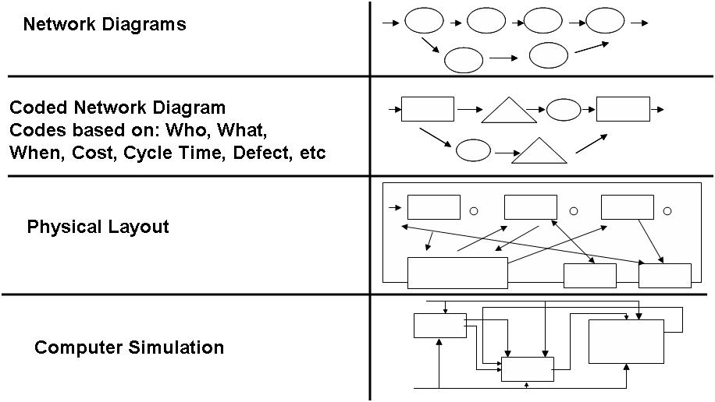
Types of Process Maps
Process Mapping Review

Slide 47
Example Process Map
Process Mapping Review
Arrive at
dealer
Meet
Salesman
Listen to
Jokes
Examine
1st Car
Examine
2nd car
Examine
3rd car
Test
drive a car?
N
Go to next
dealer
Y
Obtain
Car keys
& tag
Test drive
car
Want
car?
Make
Offer
Offer
Previewed
by sales
manager
Make
Counter
offer
Make
Another
Offer
N
Go to next
dealer
Y
Determine
Trade-in
Value
N
Salesman
confers
with
manager
Make
counter
offer
Accept
offer?
Complete
Car
paperwork
Complete
Loan
paperwork
Conduct
Credit
check
Make
Offer
Y
Wait for
Paperwork
Drive new
car home

Slide 48
Process Mapping Hints
Process Mapping Review
May need to start with a macro level map
Storyboard technique useful for mapping a process that is
well-defined
Doing the map in sequential order may help when mapping
difficult processes
Allow at least 2 – 4 hours to map a process (may be much longer for more difficult or complex maps)
Make sure that all segments of the process are represented by someone on the team
Always try to look at the worst case scenario

Slide 49
Exercise: Complete Process Map
Process Mapping Review
Objective
Complete Process Mapping exercise for your business
Instructions
Time to Complete
As a team, complete the steps to process mapping for your business.
Use the remainder of the time for this event to complete these steps and prepare for the report-out to management.
Remainder of event
Deliverable
Completed current and new process maps with improvement
actions identified.
Notes:
DO: Review the charter for this event.

Slide 50
Other Modules In This Series:
5S
Standard Work
Total Productive Maintenance (TPM)
Administrative Lean
Cell Design/ Production Preparation Process (3P)
Kaizen
Kanban
Problem Solving
Poka Yoke Quality Systems
Transaction Process Improvement (TPI)
Cause & Effect Diagram with the Additions of Cards (CEDAC)
Single Minute Exchange of Dies (SMED)
Value Stream Mapping (VSMi®)
Visual Management
Managing Daily Process Excellence
For More Information Please Contact:
Mark DeLuzio, President and CEO
+1.860.234.0915
mark.deluzio@leanhorizons.com
Strategically Creating Value Through the Elimination of Waste

